Slide 1
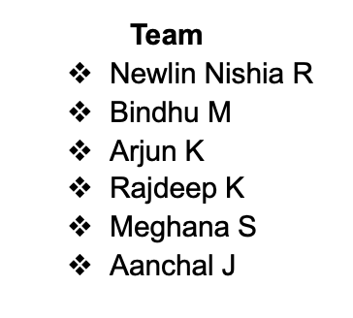
Loan Default Risk Prediction
BUAN 6340 – Programming For Data Science
Group10

Slide 2
Introduction
Defaulter- customers who are not capable of paying the loan
Non - Defaulter – Customers who are capable of paying the Loan
Goal
The goal of this project is to come up with a loan defaulter predictive model that identify potential customers and predict likelihood of defaulter.
Business Needs
This will enable the loan servicing institution to make decisions on issuing loans, so that the risk can be lowered
The profit can be maximized and help the marketing team to shift their focus on those customers who show low risk of defaulting
Notes:
Lets start with defaul

Slide 3
Project Overview
Data Collection
Data has been collected from Kaggle
https://www.kaggle.com/code/crucifer/houseloan-data-analysis/data
Exploratory Data Analysis
Data Description
Univariate Analysis
Data Preprocessing
Imputing missing values
Scaling using minmaxscaler
Bivariate Analysis
Train/ Test split
Model Building
Tested few models
Best model is selected
Feature Selection
Model optimization
Reduced feature subset
Hyperparameter tuning to improve the model performance scores
Notes:
This plot shows the overview of our project
First we started with data collection. We got the dataset from Kaggle
Then we did EDA insights generated from it helps us to understand the features and relationship between them
In data preprocessing cleaning the dataset has been performed to fit the data into the model
In model building we tested few models and based on the performance score the best model is selected
Inorder to have more generalized model we need to have reduced feature set this is accomplished through feature selection
In model optimization we have performed the hyperparameter tuning to improve the performance score

Slide 4
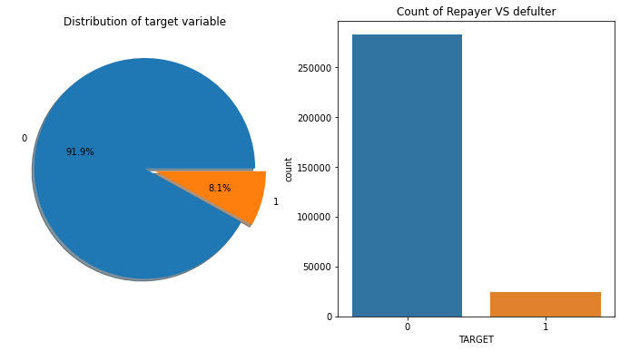
Data and population
307511 samples
122 features
Target Definition
Loan Defaulter- predicts whether an applicant can repay the loan amount or not
Data dictionary here

Slide 5
Exploratory Data Analysis

Slide 6
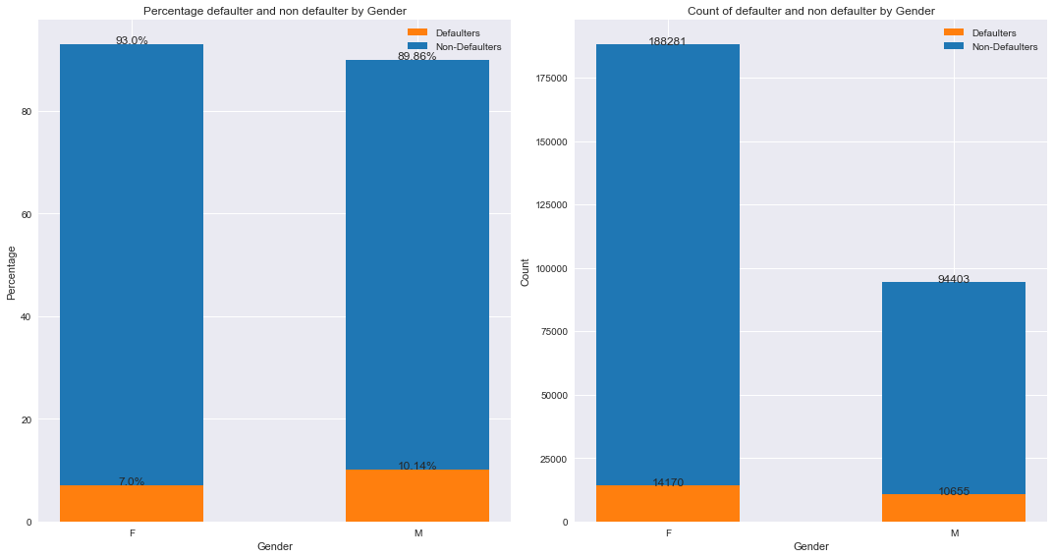
Percentage Defaulter by Gender
Women took more number of loans as compared to Men.
Women were more disciplined in repaying the loan as compared to men.
Men are able to repay their loans in 89.86% of the cases, Women are able to repay in 93.0% of the cases.
Notes:
There are entries where Gender=’XNA’. Since this is not providing us with much information, we removed those entries

Slide 7
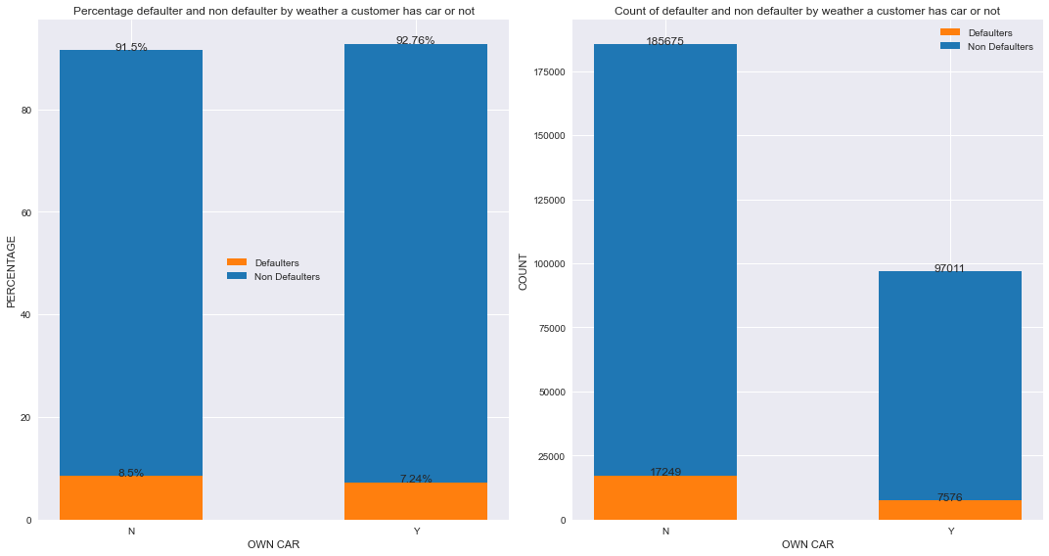
Percentage Defaulter by car ownership
Most of the applicants for loans do not own a car. However, there is not much difference in the loan defaulter status for the customer based on this information (8.5% and 7.2% respectively)

Slide 8
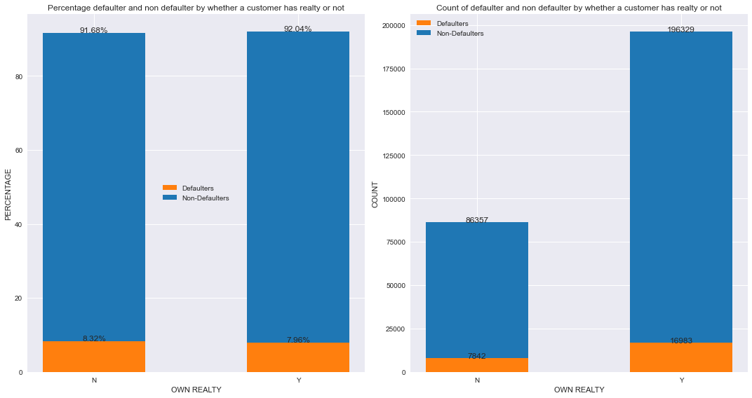
Percentage Defaulter by Realty ownership
Most of the applicants for loans own a flat/house. There is not much difference in the loan defaulter status for the customer based on this information (8.32% and 7.96% respectively)

Slide 9
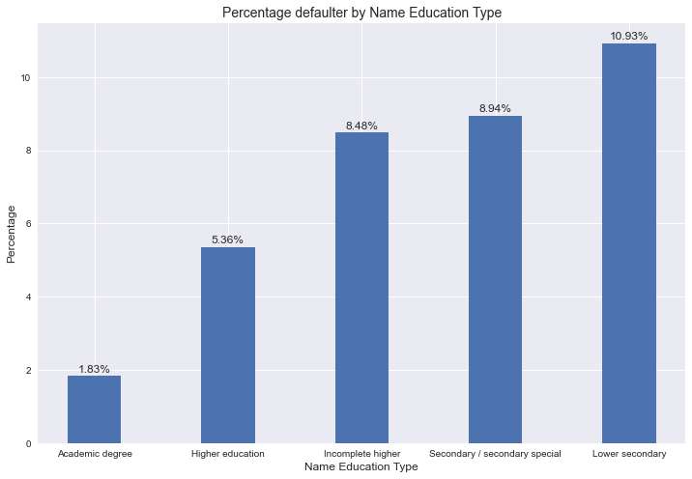
Percentage Defaulter by Education type
When a customer is having higher level of education then the loan default is less which 1.83%compared to the customers with low level of education which is 10.93%
The default rate increases when customers level of education is low.

Slide 10
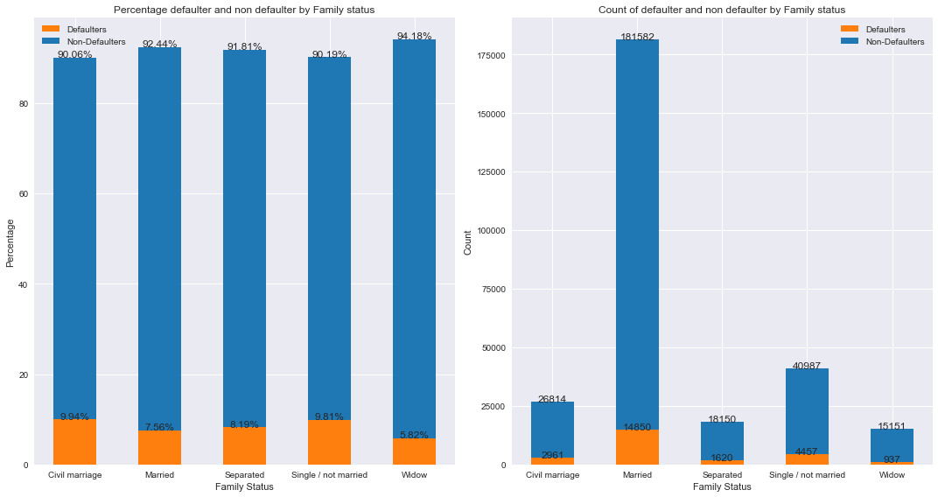
Percentage Defaulter by Family status
Married people apply for the most number of loans.
The customers who comes under the category Civil marriage has the most defaulted loans

Slide 11
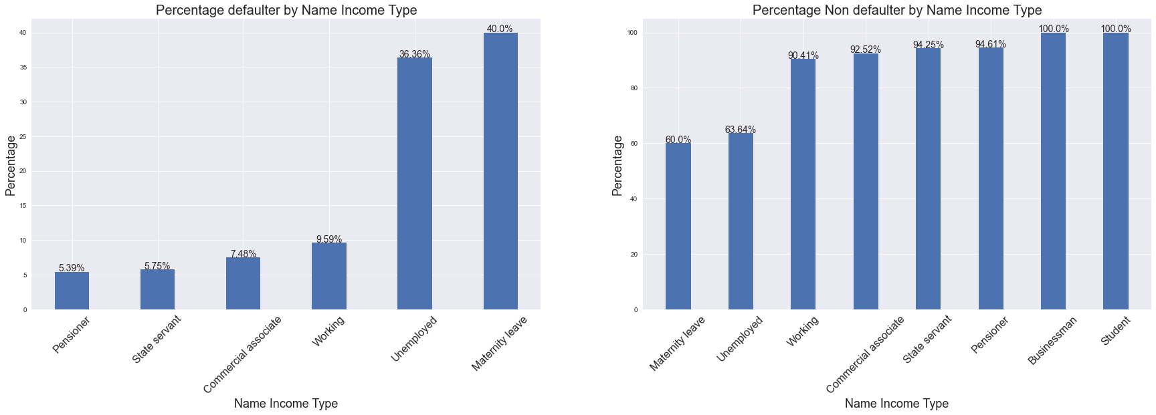
Percentage Defaulter by Income type
The women who is under maternity leave are the most defaulter when considering income type.
Student and Businessman repay the loan on time

Slide 12
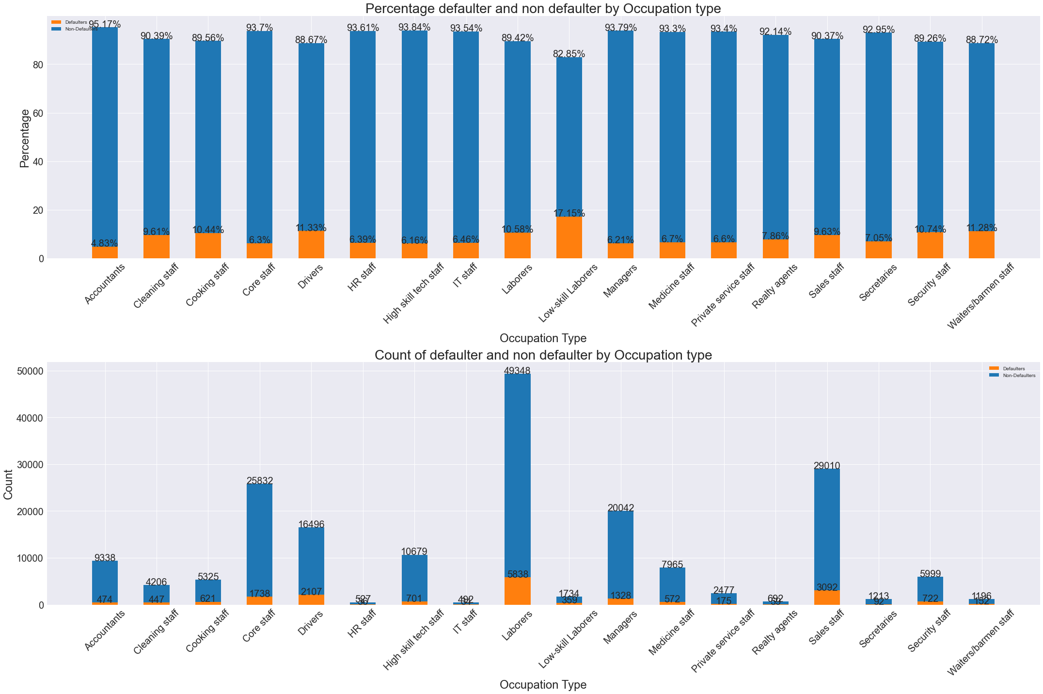
Percentage Defaulter by Occupation type
Laborers apply the most number of loans.
The percentage defaulter is higher on the low-skill laborers which is 17.15%
Customers with occupation type accountants has the least percentage default loan which is 4.83%

Slide 13
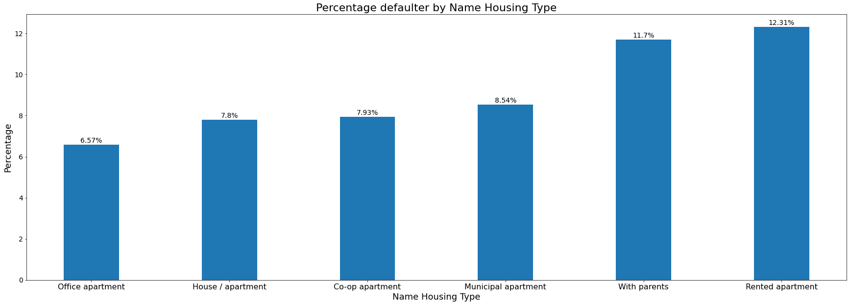
Percentage Defaulter by Name Housing Type
The customers who lives in rented apartment are the most defaulters

Slide 14
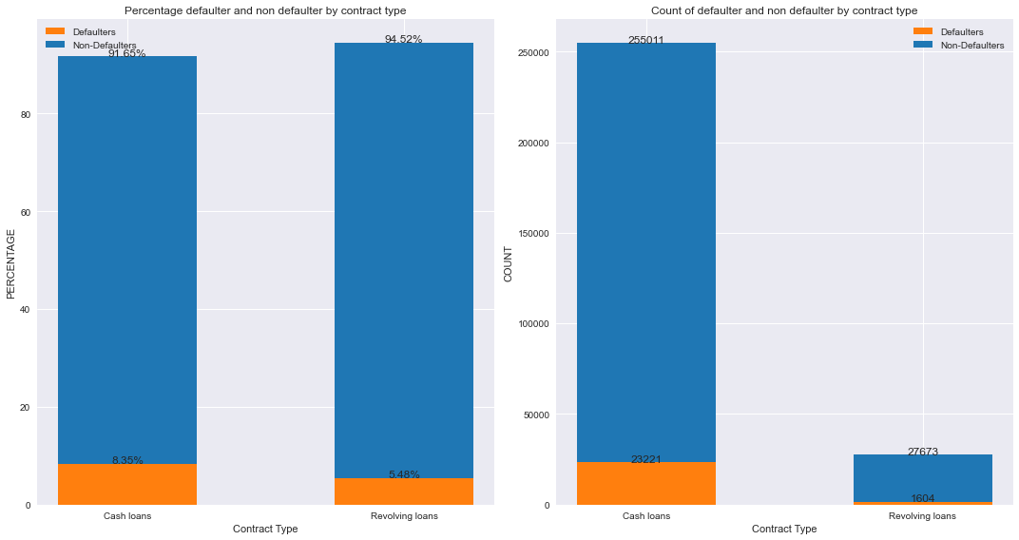
Percentage Defaulter by Contract Type
Most customers got the category cash loans in contract type
The percentage defaulters is also higher for cash loan contract type

Slide 15
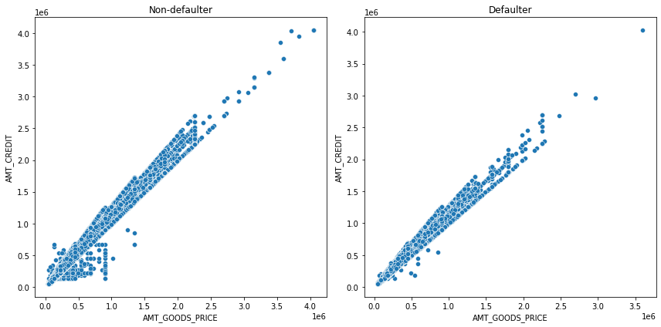
Amount Goods price Vs Amount Credit
AMT_CREDIT and AMT_GOODS_PRICE has the linear relationship for both in Defaulter and Non-defaulter case. Also, plot shows the number of Defaulter is less at the lower range

Slide 16
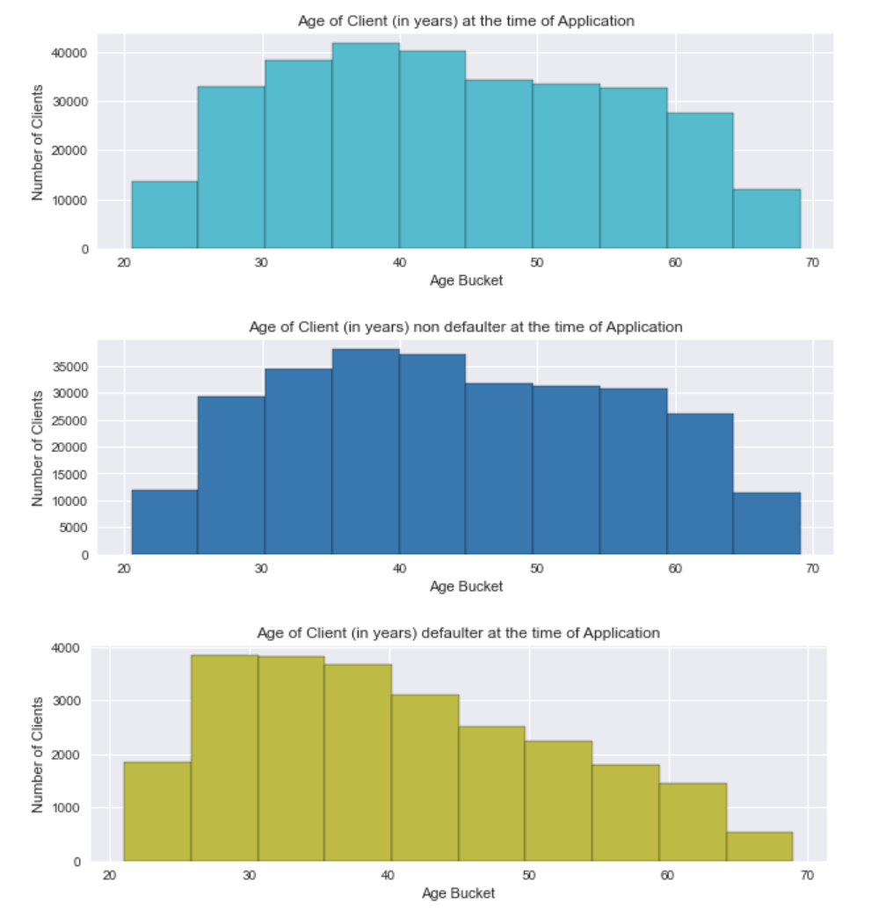
Analysis on Age
- Most number of people applying for loans are in the range of (35-40) years followed by people in the range of (40-45) years
- The number of applicants in people aged <25 or aged>65 is very low
- The people who are non defaulter of loan repayment are in the (35-40) years range
- The people who defaulter of loan repayment are in the (25-35) years range

Slide 17
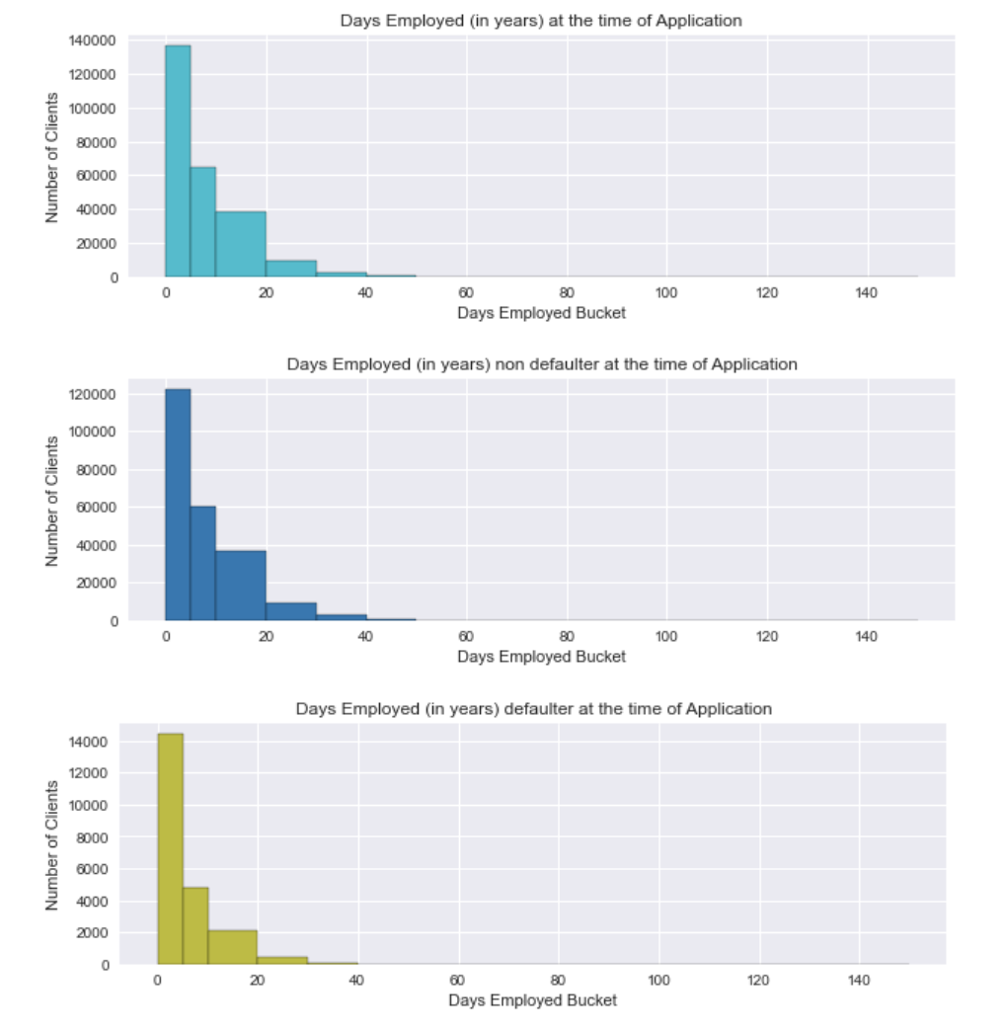
Analysis on Years Employed
More than 55% of the loan applicants have work experience within (0-5) years of work experience
Also, the non defaulters and defaulters are from the (0-5) years of work experience

Slide 18
Data Preprocessing

Slide 19
preprocessing steps
Identifying outliers
AMT_ANNUITY, AMT_CREDIT, AMT_GOODS_PRICE,CNT_CHILDREN have some number of outliers.
DAYS_EMPLOYED has outlier values around 350000(days) which is around 958 years which is impossible and hence this has to be incorrect entry so we dropped it
Identifying correlated features
Dropped the correlated Feature
Numerical Features
Imputing missing values with median
Scaling is performed using minmax scalar
Categorical Features
Imputing missing values with most frequent category
One hot encoding is performed to convert the categorical values to numerical
Train/Test split-70%/30%
Evaluation Metric: ROC_AUC score
Notes:
From the target distribution plot we have our dataset to be highly imbalanced so we have used roc auc metric for evaluation.This metric ranges between 0.5 to 1. when the model performance scores are near to 1 then the model better rank order the population.

Slide 20
Model Building

Slide 21
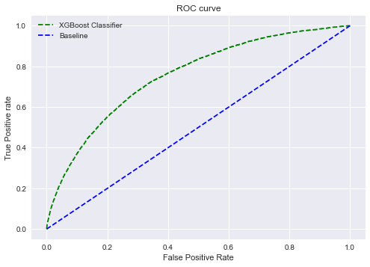
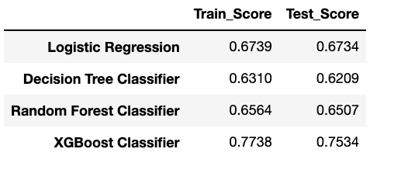
Model Performance Score Comparison
Tested Models
Logistic Regression
Decision Tree
Random Forest Classifier
XGBoost Classifier
XGBoost Classifier is a good fit model with higher roc_auc score
Notes:
When the curve is further away from the baseline then the model is good under prediction

Slide 22
Feature Selection

Slide 23
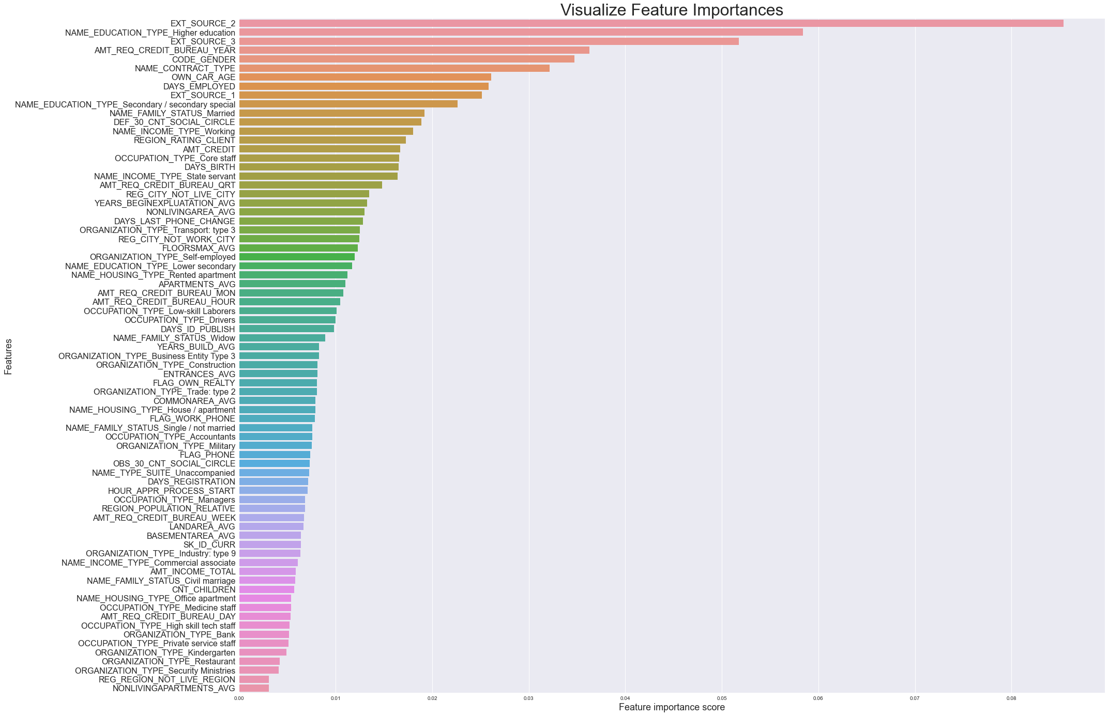
Feature Selection Plot

Slide 24
Model Optimaization

Slide 25
Model Optimization steps
Hyperparameter tuning has been performed
Best model parameters are selected
Fitted the selected parameters and selected features to the model
Final performance score is 0.749 roc_auc for the test dataset

